Slide 1
Agile Fundamentals

Slide 2
Agenda
Agile Manifesto
Agile Fundamental Concepts
Agile Approaches
Agile Roles
Agile Ceremonies
Q&A

Slide 3
Agile Manifesto
We are uncovering better ways of developing software by doing it and helping others do it. Through this work we have come to value:
Individuals and interactions over process and tools
Working software over comprehensive documentation
Customer collaboration over contract negotiation
Responding to change over following a plan
That is, while there is value in the items on the right, we value the items on the left more.
Notes:
We are uncovering better ways of developing software
by doing it and helping others do it.
Through this work we have come to value:
3

Slide 4
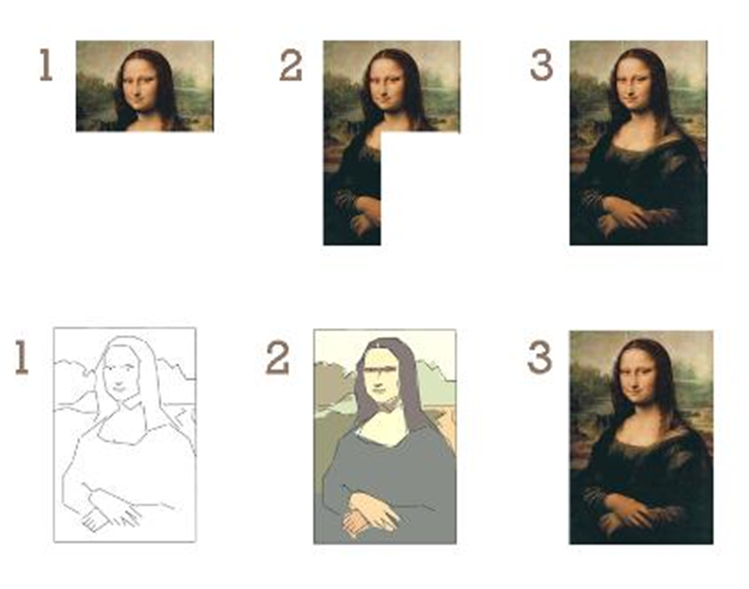
Agile Fundamental Concepts
1. Value Driven Delivery
Deliver value by understanding and prioritizing what is important to the customer and the business, providing quality results incrementally, and obtaining feedback to improve the result delivered.

Slide 5
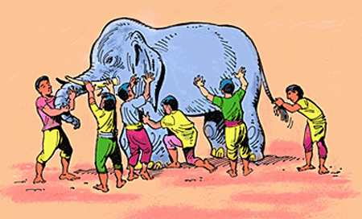

Agile Fundamental Concepts
2. Stakeholder Engagement
Establishing and maintaining mechanisms that ensure that all current and future interested parties are appropriately participating throughout the lifecycle of the project.

Slide 6
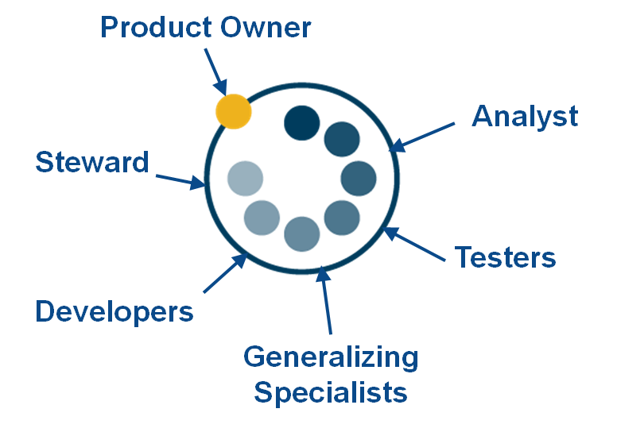
Agile Fundamental Concepts
3. Boost Team Performance
Boost team performance through creating an environment of trust, learning, collaborative decision making, commitment and conflict resolution, thereby enhancing relationships amongst individual team members.

Slide 7
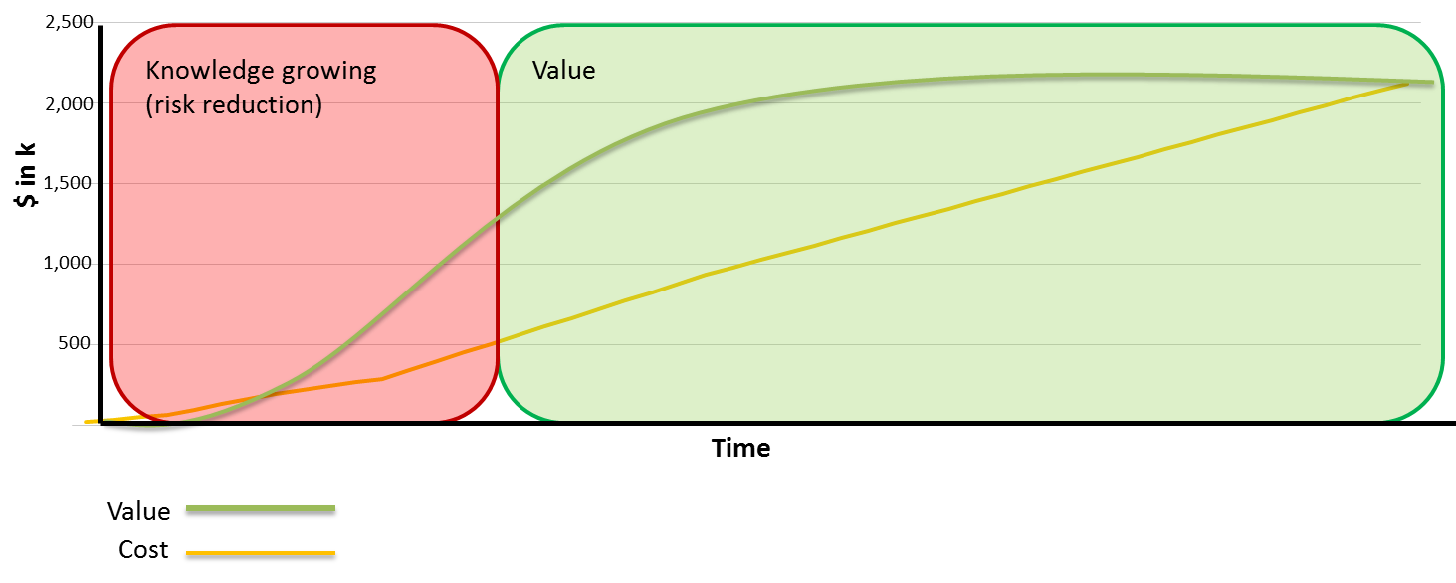
Agile Fundamental Concepts
4. Adaptive Planning
Work with the team and the stakeholders to produce and maintain an evolving plan from initiation to close based on goals, business values, risks, constraints, and stakeholder feedback.

Slide 8
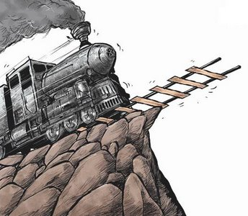
Agile Fundamental Concepts
5. Problem Detection and Resolution
Identify problems, impediments, and risks; determine strategies for dealing with them; and execute the strategy.

Slide 9


Agile Fundamental Concepts
6. Continuous Improvement
Reflect on performance and improve the quality, effectiveness, and flexibility of the product, process and team and influence the organization in order to better deliver value now and in the future.

Slide 10
Agile Roles
Delivery Team
A team that has everything they need to deliver a working increment of tested, documented, deployable software at the end of every sprint.
Notes:
Most Agile Literature talks about this – the Agile Team.

Slide 11

Delivery Teams
Delivery Team
Notes:
Most Agile Literature talks about this – the Agile Team.

Slide 12
Delivery Teams
Developers
Notes:
Most Agile Literature talks about this – the Agile Team.

Slide 13
Delivery Teams
Testers
Developers
Notes:
Most Agile Literature talks about this – the Agile Team.

Slide 14
Delivery Teams
Analyst
Testers
Developers
Notes:
Most Agile Literature talks about this – the Agile Team.

Slide 15
Delivery Teams
Analyst
Testers
Developers
Specialists
Notes:
Most Agile Literature talks about this – the Agile Team.

Slide 16
Delivery Teams
Analyst
Testers
Developers
Generalizing Specialists
Notes:
Most Agile Literature talks about this – the Agile Team.

Slide 17
Delivery Teams
Analyst
Process Coordinator
Testers
Developers
Generalizing Specialists
Notes:
Most Agile Literature talks about this – the Agile Team.

Slide 18
Delivery Teams
Analyst
CSM
Testers
Developers
Generalizing Specialists
Notes:
Most Agile Literature talks about this – the Agile Team.

Slide 19
Delivery Teams
Analyst
Kanban Master
Testers
Developers
Generalizing Specialists
Notes:
Most Agile Literature talks about this – the Agile Team.

Slide 20
Delivery Teams
Analyst
Team Lead
Testers
Developers
Generalizing Specialists
Notes:
Most Agile Literature talks about this – the Agile Team.

Slide 21
Delivery Teams
Analyst
Steward
Testers
Developers
Generalizing Specialists
Notes:
Most Agile Literature talks about this – the Agile Team.

Slide 22
Delivery Teams
Analyst
Scrum Master
Testers
Developers
Generalizing Specialists
Notes:
Most Agile Literature talks about this – the Agile Team.

Slide 23
Scrum Master
Ensures the delivery team is functional and productive
Facilitates Daily Stand Up
Facilitates Sprint Planning
Facilitates Sprint Review
Facilitates Retrospective
Participates in Release Planning Meeting
Removes Impediments
Facilitates Improvements

Slide 24
Product Owner
Product Owner
Analyst
Steward
Testers
Developers
Generalizing Specialists
Notes:
Most Agile Literature talks about this – the Agile Team.

Slide 25
Product Owner
Responsible for the business value of the project
Ensures the product owner team is functional and productive
PO Steward/ rep(s) optionally participate in Daily Stand Up
PO Steward and rep(s) prepare for and participate in Sprint Planning
PO Steward and rep(s) participate in Sprint Review
PO Steward/ rep(s) optionally participate in Retrospective
Prepares for and Facilitates Release Planning Meeting
Facilitates Product Owner Improvements

Slide 26

Product Owner Team
Product Owner

Slide 27
Product Owner Team
Product Owner Team
A team that has everything they need to:
identify and prioritize business value increments,
scope the smallest solution that might possibly deliver on the business value increment,
prepare the runway for the delivery teams,
coordinate the implementation of the business value increment when it is delivered.
Notes:
Most Agile Literature talks about this – the Agile Team.

Slide 28
Product Owner Team
Product Owner
Team

Slide 29
Product Owner Team
Product Manager

Slide 30
Product Owner Team
Product Manager
Governance

Slide 31
Product Owner Team
Product Manager
Governance
Business Analyst

Slide 32
Product Owner Team
Product Manager
Governance
Business Analyst
UAT / IVV

Slide 33
Product Owner Team
Product Manager
Governance
Business Analyst
Project Manager
UAT / IVV

Slide 34
Product Owner Team
Product Manager
User Experience
Governance
Business Analyst
Project Manager
UAT / IVV

Slide 35
Product Owner Team
Product Manager
Steward
User Experience
Governance
Business Analyst
Project Manager
UAT / IVV

Slide 36
Product Owner Team
Product Manager
Product Owner
User Experience
Governance
Business Analyst
Project Manager
UAT / IVV

Slide 37
Product Owner Team
Product Manager
Product Owner
User Experience
Governance
Business Analyst
Project Manager
Delivery
UAT / IVV

Slide 38
Agile Approaches Scrum-Roles and Ceremonies
Three Roles
Product Owner
Team (Delivery Team)
Scrum Master
Artifacts
Product Backlog
Sprint Backlog
Working Tested Deployable Software
Ceremonies
Sprint Planning
Daily Standup
Sprint Review
Sprint Retrospective

Slide 39
Agile Approaches Kanban-Ongoing Improvement
Make Work Visible
A more explicit task board than scrum
Limit Work in Progress
Explicitly limit the number of tasks, stories, features, and epics
Help Work to Flow
Focus on optimizing for flow – not optimization or number of projects active at a time
Make policies explicit
Management inclusion
Evolutionary change
Improve processes using improvement models based on performance data

Slide 40
Agile Approaches XP-Technical Excellence
Fine scale feedback
Pair programming
Planning game
Test Driven Development
Whole Team (Acceptance Tests)
Continuous Process
Continuous Integration
Refactoring
Small Releases
Coding Standards
Shared Understanding
Collective Code Ownership
Simple Design
System Metaphor
Programmer Welfare
Sustainable Pace

Slide 41
Agile Approaches Feature Driven Development
Develop an overall model
Develop a high-level model of the system and use peer review and discussion to refine
Build a feature list
Create a list of features (client valued increment of functionality) from the high level model
Plan by feature
Progressively elaborate features
Design by feature
Develop specifications for each feature
Build by feature
Develop, test, and promote the feature

Slide 42
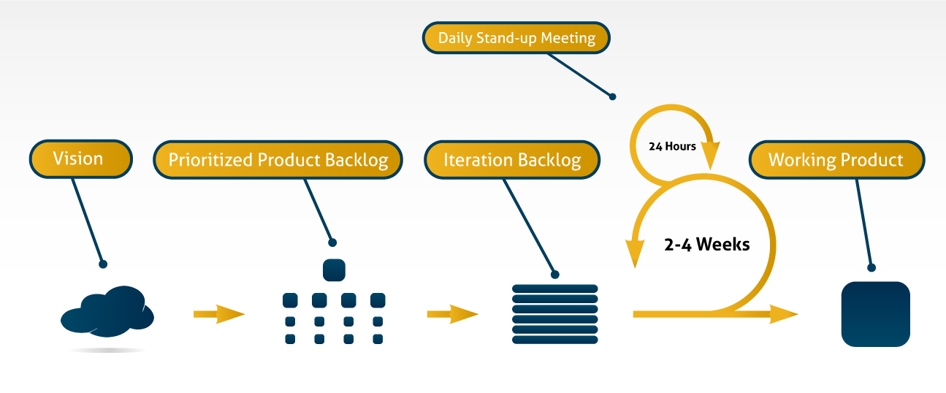
Overall Flow

Slide 43
Visioning

Slide 44
Visioning
Product owner
Prepares product vision, strategy and goals
Participants as needed
Everyone proposes a set of Product Stories
Not by architecture layer – a discrete set of value
Customer value and frequency and business priority
Define risks associated stories with the product stories
Organizational risk: Does the delivery team do it
Technical risk: Do we have the technology to do it
Business risk: Do we have clear business outcomes
Architecture, UX, and Design
Define Architecturally significant stories
Perform sufficient design to provide roadmap

Slide 45
Release Planning

Slide 46
Release Planning
Release Planning Inputs
A focused goal for the release
A prioritized set of user stories – business value ranking
Risks associated with the stories
Release Planning Process
The delivery team assesses the groomed backlog
Split the stories into small enough to plan
Order the stories into the current release (the smallest product where the benefits outweigh the cost of releasing), the following release, and future releases
Prioritize the stories and risks in the current release
Plan to address risks ahead of the related stories

Slide 47
Specification

Slide 48
Specification
Groom the Backlog
Product Owner Team works with Delivery Team to prepare Specifications (Acceptance Criteria, Screenshots, Mock-Ups, Use Case Updates, etc.) for Sprint Planning
Stories will have sufficient specification to allow teams to adequately plan and commit to the Sprint
The delivery team will have sufficient insight prior to the Sprint Planning to responsibly participate in Sprint planning

Slide 49
Sprint Cadence
Scheduled in Advance
Sprint Planning
Daily Standups
Sprint Review
Retrospective
No Surprises

Slide 50
Sprint Planning

Slide 51
Sprint Planning
Review the highest priority stories in backlog
Make sure stories are “ready” to be delivered – identify sufficient stories to fill the next sprint
The delivery team will decompose the stories into the tasks required to deliver on the sprint
The tasks will be estimated in ideal hours by the delivery team with no task being greater than 6-8 hours
The delivery team will include tasks to address risks associated with the stories committed in the sprint
Stories may be further split for future sprints by explicitly identifying the acceptance criteria for the current sprint (dirt road, gravel road, etc)

Slide 52
Daily Standup

Slide 53
Daily Standup Meeting
Daily Stand-ups are where the team self organizes
These follow the same pattern of drive risk down early and deliver value
Everyone commits to attending the daily standup, being “present” during the standup, and engaging to support the team
Tasks are pulled – not assigned – in the daily standup
Problems are not resolved in the daily standup. After meetings are scheduled at the daily standup – these are placed on a meeting roster or as tasks on the board

Slide 54
Sprint Review/ Product Demo

Slide 55
Sprint Review/ Product Demo
The delivery team reviews the stories delivered against the agreed upon acceptance criteria with the product owner team
The product owner team provides feedback on the product and the success of the delivery team
Only 100% completed stories (delivered, tested, deployable, and documented) are presented
Demonstrate completed functionality to interested stakeholders and/or customers

Slide 56
Retrospective

Slide 57
Retrospective
This is attended by the delivery team
Three questions:
What is working?
What is not working?
What changes can help the team?
Candidly focus on overall performance and identify strategies to improve its processes
Review retrospective parking lot items capturing during the sprint
The team lead / team coach can make suggestions to the team about improving performance
Agree to take explicit actions to improve performance
Update documentation in the team room to reflect changes
Hold the team accountable for the updated working agreements

